Slide 1



Objects & Classes in ECMAScript 6.0
Eyal Vardi
Microsoft MVP ASP.NET blog: eyalvardi.wordpress.com

Slide 2
Initializer Shorthand
function Person(name, age) {
return {
name: name,
age : age,
sayName: function(){ console.log();
}
};
}

Slide 3
Initializer Shorthand
function Person(name, age) {
return {
name,
age,
sayName(){ console.log();
}
};
}

Slide 4
Computed Property Names
var lastName = "last name" ;
var person = {
lastName : lastName ,
"first name" : "Eyal" ,
[lastName] : "Vardi"
};
console.log(person[ "first name" ]); // "Eyal"
console.log(person[lastName]); // Vardi

Slide 5
Computed Property Names
var lastName = "last name" ;
var person = {
"first name" : "Eyal" ,
[ lastName + "☺" ] : "Vardi"
};
console.log( person[ "first name" ] ); // "Eyal"
console.log( person[lastName + "☺"] ); // Vardi

Slide 6
Object Destructuring
Variables can also be initialized from an object that is returned from a function even with deeply nested objects.
function equinox2() {
return { date: 20, month: "March", year: 2015,
time: { hour: 11, minute: 2 }
};
}
var { date: d, month: m, time : { hour: h} } = equinox2();
// 20 March at 11
console.log(d + " " + m + " at " + h);

Slide 7
Array Destructuring
With array destructing, we can initialize variables at once, or even swap them instead of having the conventional way of creating a var temp; temporary variable.
var [start, end] = ["earth", "moon"] // initialize
console.log(start + " => " + end); // earth => moon
[start, end] = [end, start] // swapping
console.log(start + " => " + end); // moon => earth
function equinox() { return [20, "March", 2013, 11, 02]; }
var [date, month, , ,] = equinox();
console.log( date +" "+ month); // 20 March

Slide 8
Object.assign()
The method accepts any number of suppliers, and the receiver receives the properties in the order in which the suppliers are specified.
That means the second supplier might overwrite a value from the first supplier on the receiver.
function mixin(receiver, supplier) {
Object.keys(supplier).forEach( function(key) {
receiver[key] = supplier[key];
});
return receiver;
}
// == Object.assign(receiver, supplier);

Slide 9
Fn() vs. new Fn()

Slide 10
The Constructor Pattern
Calling a constructor causes the following:
Create a new object.
Assign the this value of the constructor to the new object.
Execute the code inside the constructor.
Assign to __proto__ property of the new object the function prototype.
Return the new object.
alert(person1.constructor == Person); //true
alert(person2.constructor == Person); //true

Slide 11
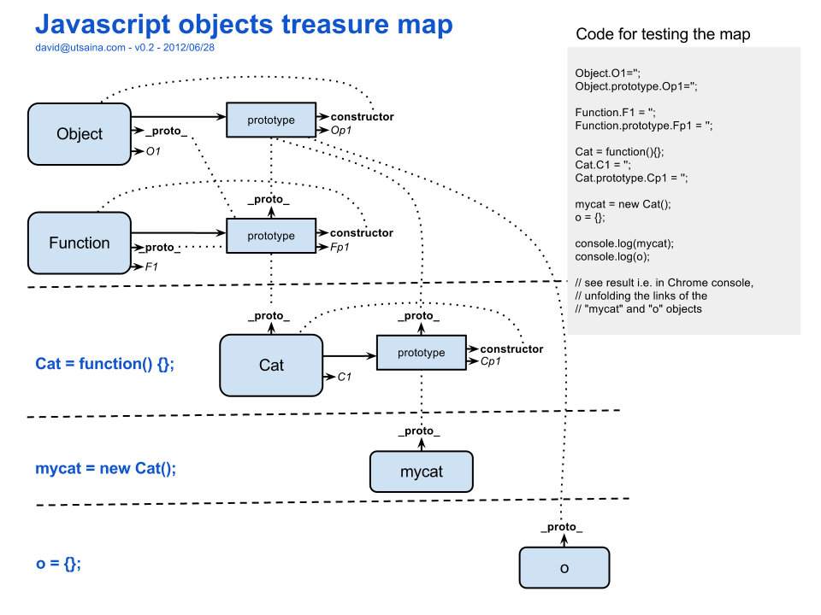

Slide 12
Full Solution Inheritance in ES 5.0
function SuperType(name){
this.name = name;
this.colors = ['red', 'blue', 'green'];
}
SuperType.prototype.sayName = function(){ return this.name; };
function SubType(name, age){
SuperType.call(this, name);
this.age = age;
}
SubType.prototype = Object.create(SuperType.prototype);
SubType.prototype.constructor = SubType;
SubType.prototype.sayAge = function(){
alert(this.age);
};
SubType.prototype.sayName = function(){
return SuperType.prototype.sayName.call(this) + "!!";
};
fix constructor
override

Slide 13
C# Class
public class Person : BasePerson
{
public string FirstName { get; set; }
public string LastName { get; set; }
public Person(string FirstName, string LastName) : base()
{
this.FirstName = FirstName;
this.LastName = LastName;
}
public string GetFullName(){
return FirstName + " " + LastName;
}
}

Slide 14
ES 6.0 Class
class Person extends BasePerson {
constructor(firstName, lastName) {
super();
this._firstName = firstName;
this._lastName = lastName;
}
getFullName(){
return this.firstName + " " + this.lastName;
}
get firstName() { return this._firstName; }
set firstName(value) { this._firstName = value; }
get lastName() { return this._lastName; }
set lastName(value) { this._lastName = value; }
}

Slide 15
Object.setPrototypeOf()
Allows you to change the prototype of any given object.
Normally, the prototype of an object is specified at the time of its creation, either by using a constructor or via Object.create().
SubType.prototype = Object.create(SuperType.prototype);
=
var objPro = {};
Object.setPrototypeOf( objPro , SuperType.prototype );
SubType.prototype = objPro;

Slide 16
Methods vs. Functions
ECMAScript 6 formally defines a method as a function that has an internal [[HomeObject]] property containing the object to which the method belongs.
Function.toMethod([[HomeObject]])
Allows you to create a new version of the same function that has its [[HomeObject]] set to a specific object.

Slide 17
toMethod()
// prototype is person
let friend = {
__proto__: person,
getGreeting() {
return super() + ", hi!" ;
}
};
function getGreeting() {
return super.getGreeting() + ", yo!" ;
}
console.log(friend.getGreeting()); // "Hello, hi!"
// assign getGreeting to the global function
var getFriendlyGreeting = getGreeting.toMethod(friend);
console.log(getFriendlyGreeting()); // "Hello, yo!"

Slide 18
Super References
Determine the [[HomeObject]]
Call Object.getPrototypeOf( [[HomeObject]] )
Searched for a function with the same name as the executing function.
Binding the “this” to the function.
Execute the function.
let friend = {
__proto__: person,
getGreeting() {
// same as Object.getPrototypeOf(this).getGreeting.call(this)
// or this.__proto__.getGreeting.call(this)
// or super.getGreeting()
return super() + ", hi!" ;
}
};

Slide 19
Super in Constructor
class Polygon {
constructor(height, width) {
this.height = height;
this.width = width;
}
}
class Square extends Polygon {
constructor(length) {
super(length, length); this.name = 'Square';
}
get area() {
return this.height * this.width;
}
}

Slide 20
Resources
2ality blog (http://www.2ality.com/)
Understanding ECMAScript 6
http://ecmascript6.org/
A Few New Things Coming To JavaScript
Harmony of Dreams Come True
Harmony specification_drafts

Slide 21
Thanks
eyalvardi.wordpress.com
Eyal Vardi
Microsoft MVP ASP.NET blog: eyalvardi.wordpress.com

